Slide 1

India Police Hackathon 2019
Team: Park Bench, Deloitte (Table 36)
Members:
Harshit Bhadauria Sharadhi Hosamani Atish Ray
Rohit Varma
Kandaswamy Subramaniyam

Slide 2
Objective
To create a Unified Communication App for Police Department with features of:
Creating/assigning tasks and tracking of task from assignment till completion at particular level Internal police department chat at all levels
Chat data wiped out feature in 10 hours whereas data marked confidential will have 60 seconds life once read in app. All data/media will be stored permanently on server once opened/read.
Contact details are expected to be retrieved from backend with end to end encryption throughout application
User level permissions and Authorization, Authentication and Audit trails for login features

Slide 3
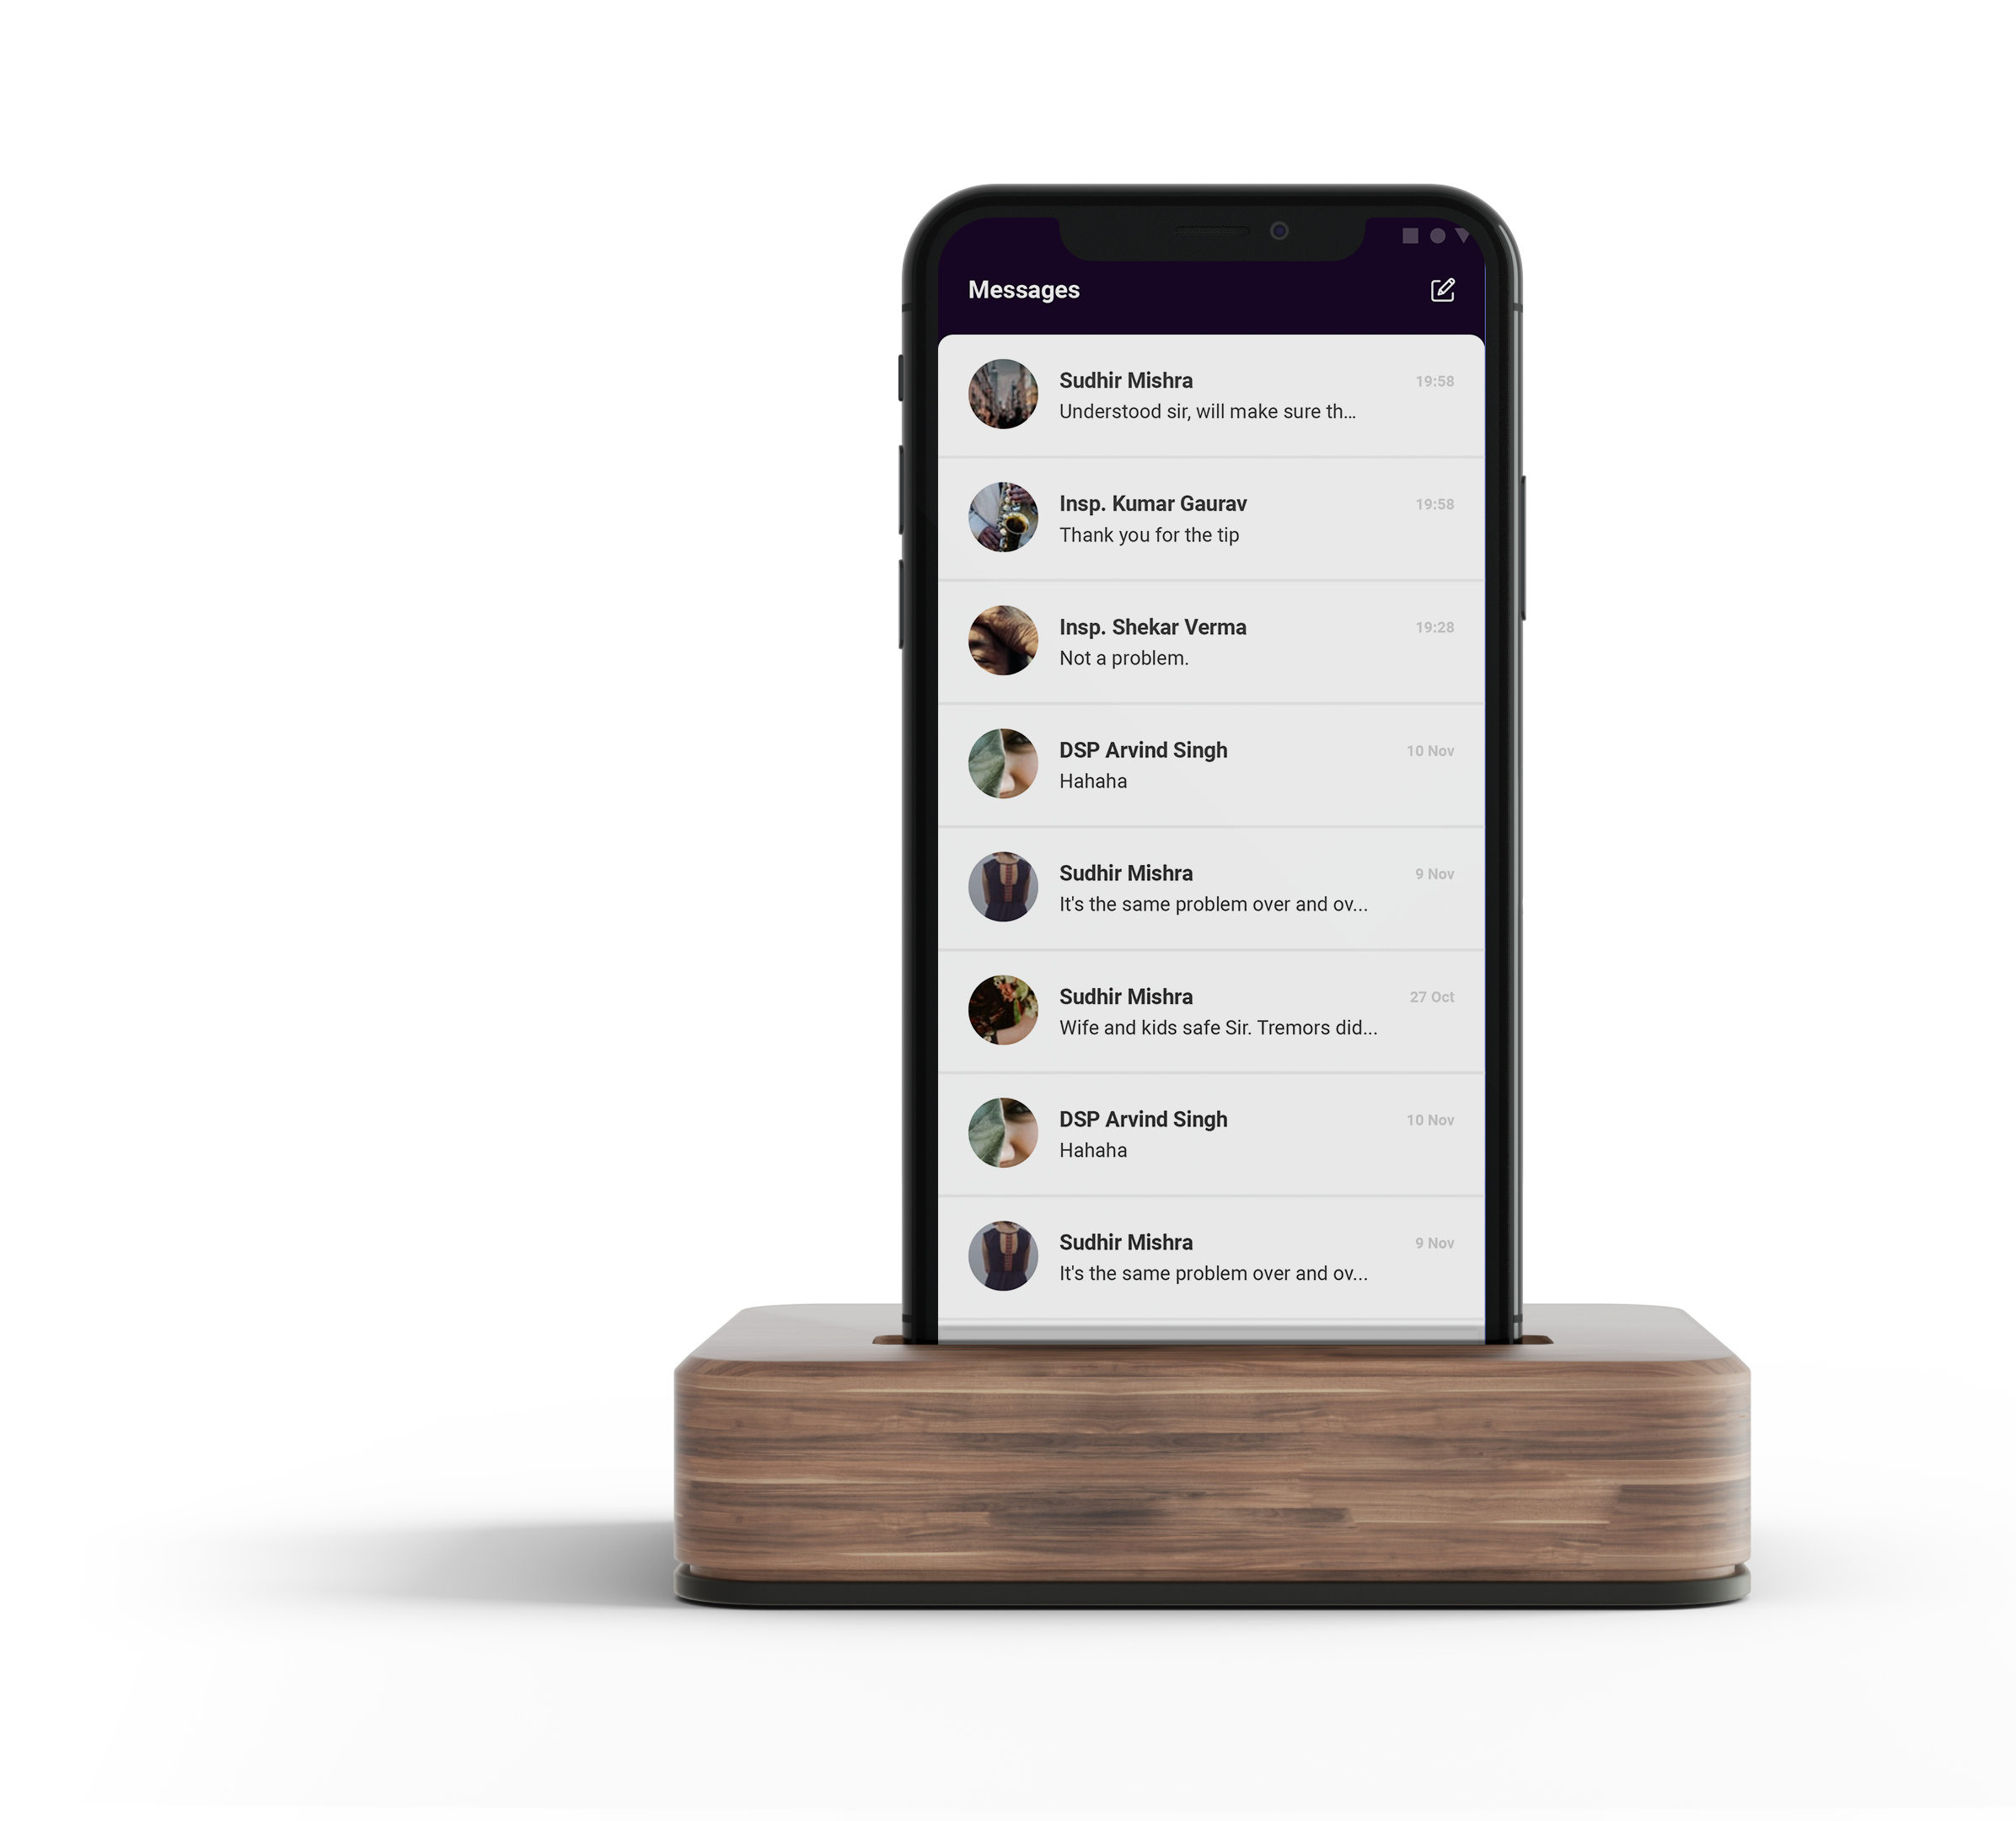
Solution: SPARC
(State Police Application for Real-time Collaboration)
SPARC App provides one stop solution by targeting both IOS and Android through XAMARIN thereby saving up to 70% of overall turnaround time spent on creating two separate application for individual platforms.
It provides built in cross-platform support which has made it best choice for application development.
The features and flexibility of FIREBASE specially for database and mobile phone OTP authentication has again helped in development and targeting application closure.

Slide 4
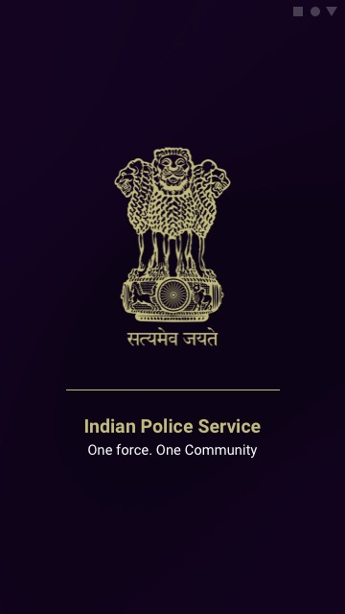
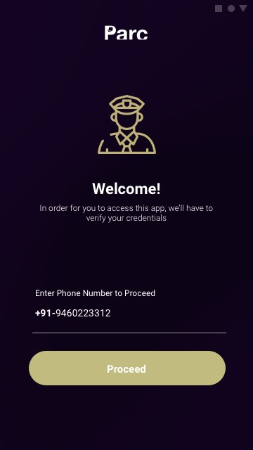
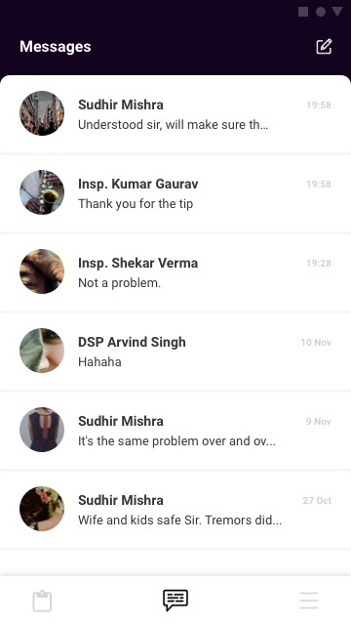
App Screens
Splash
Login
Chat Screen

Slide 5
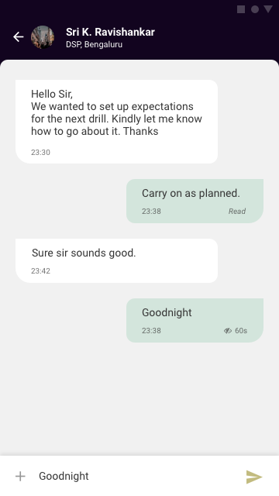
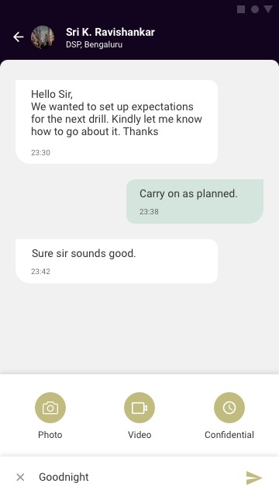
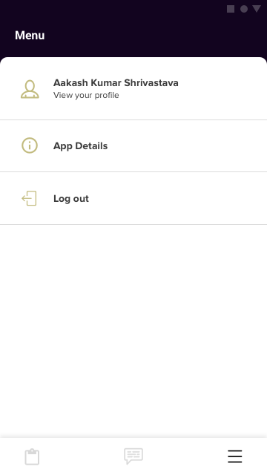
App Screens
Chat UI
Chat UI Additional
App Menu

Slide 6
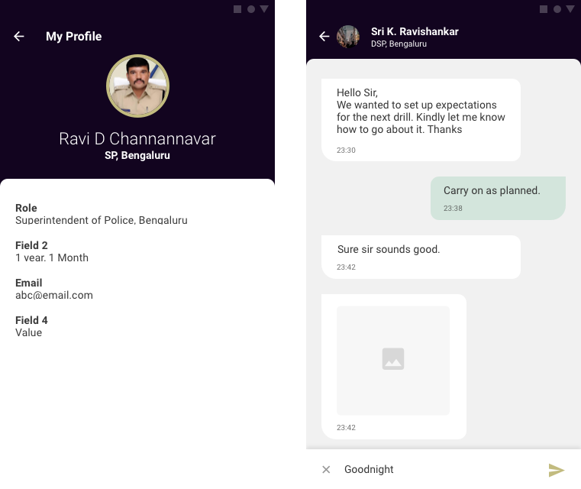
App Screens
App Profile
Chat UI Media

Slide 7
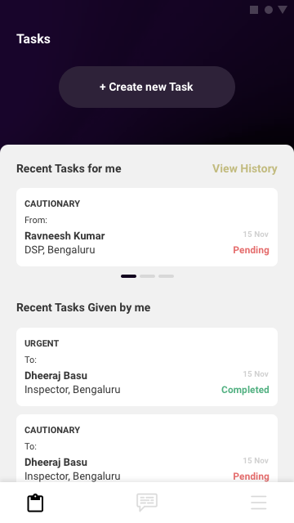
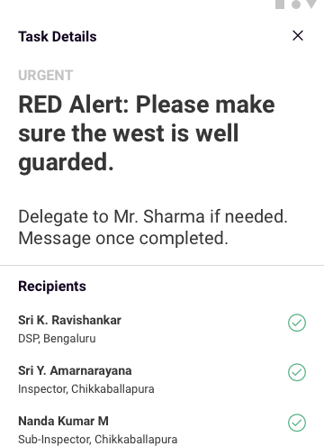
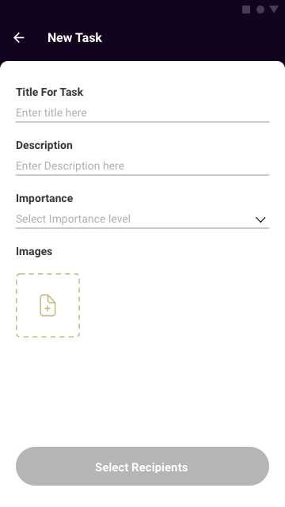
App Screens
Tasks Home
Task Details
Create Task

Slide 8




Tech Stack
XAMRIN: Native Mobile App Development
FIREBASE: Database
SKETCH: Design Tool
ZEPLIN: Design handover tool to be consumed by App Developers

Slide 9
Thank you

